Slide 1
Final Demonstration–Group 6
Dang The Hung
Huiluomin Shen
Yiqi Ma
Mustafa Kafaji

Slide 2
CONTENTS
01
02
03
04
Assembly &Electronics
CAD/3DP
Arduino
Matlab

Slide 3
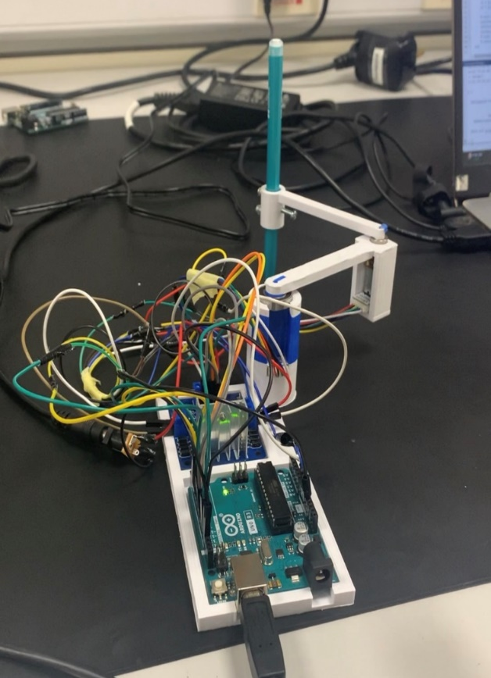
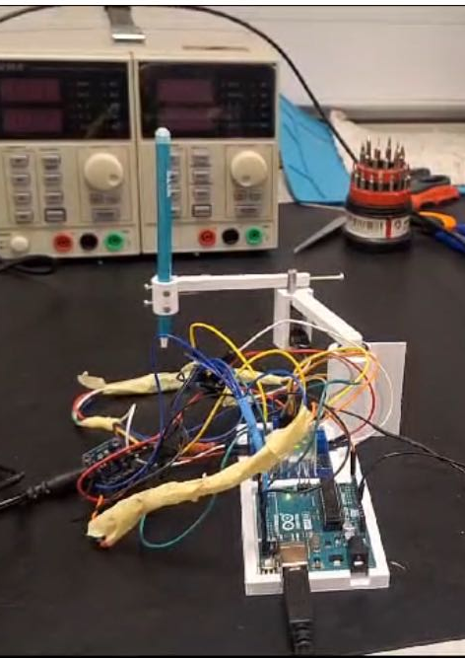
Assembly &Electronics

Slide 4
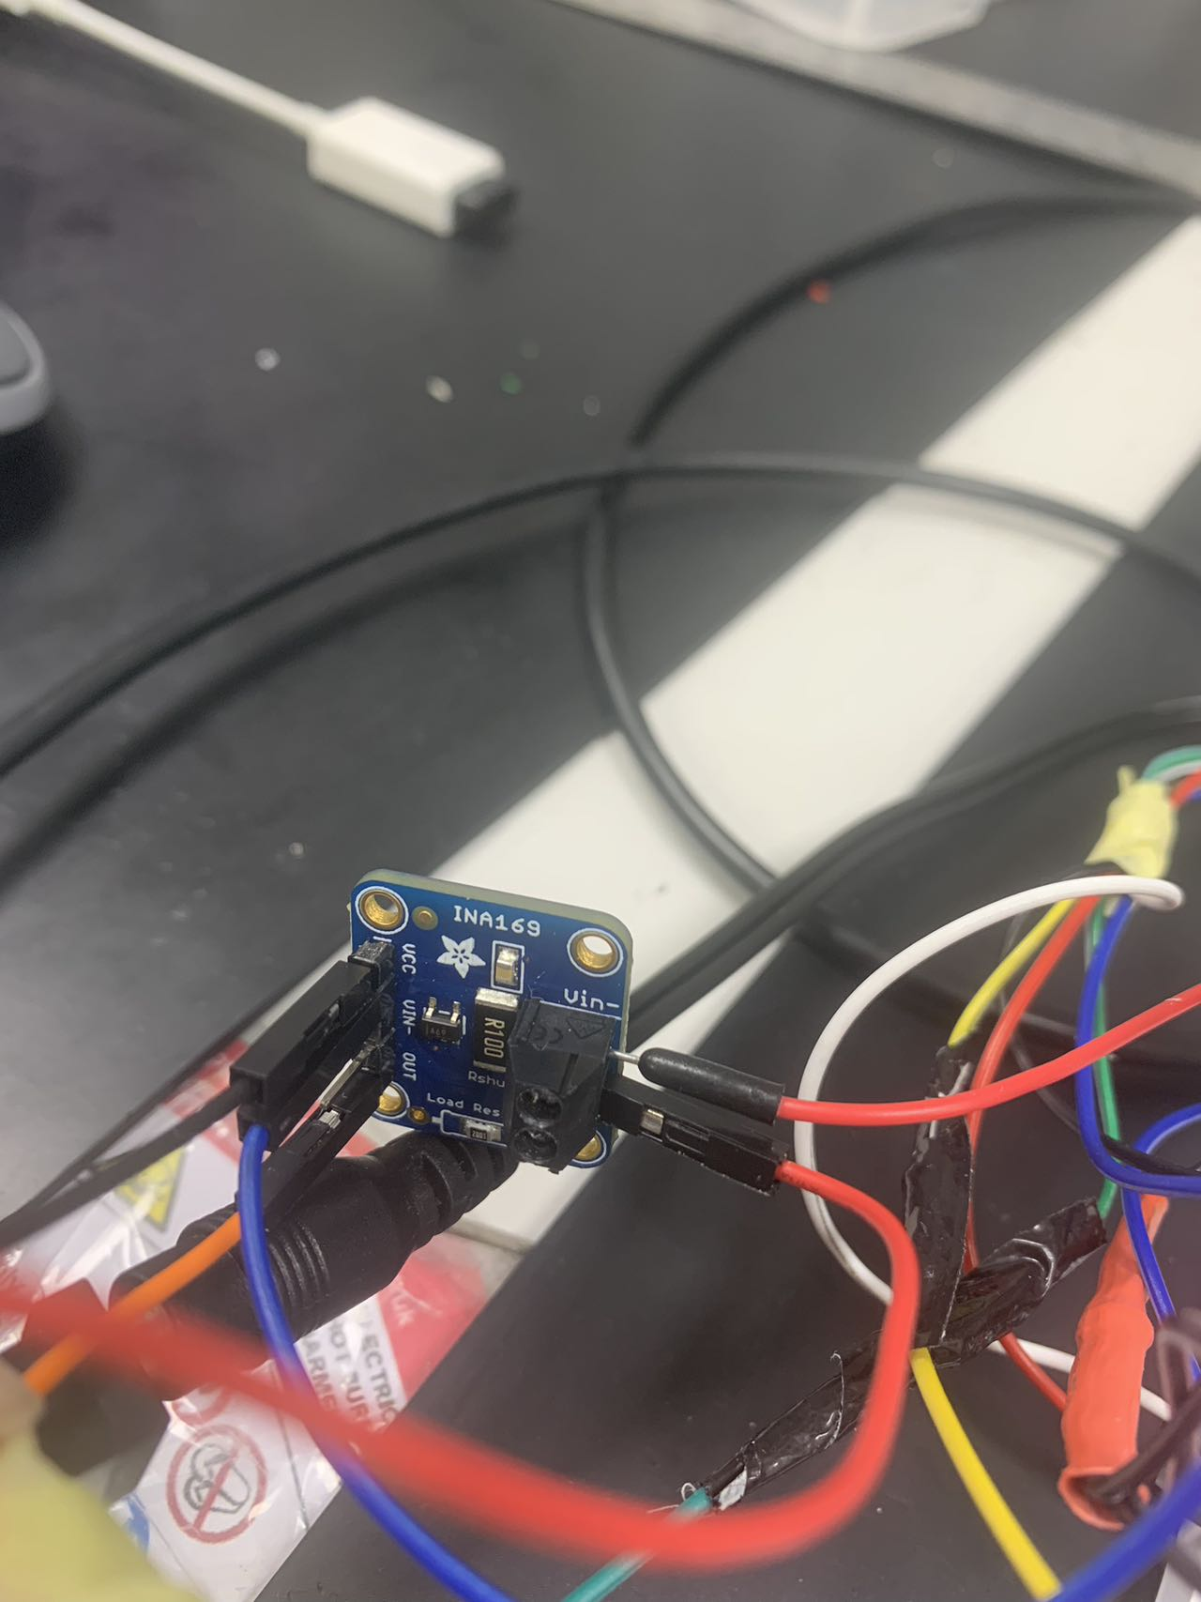
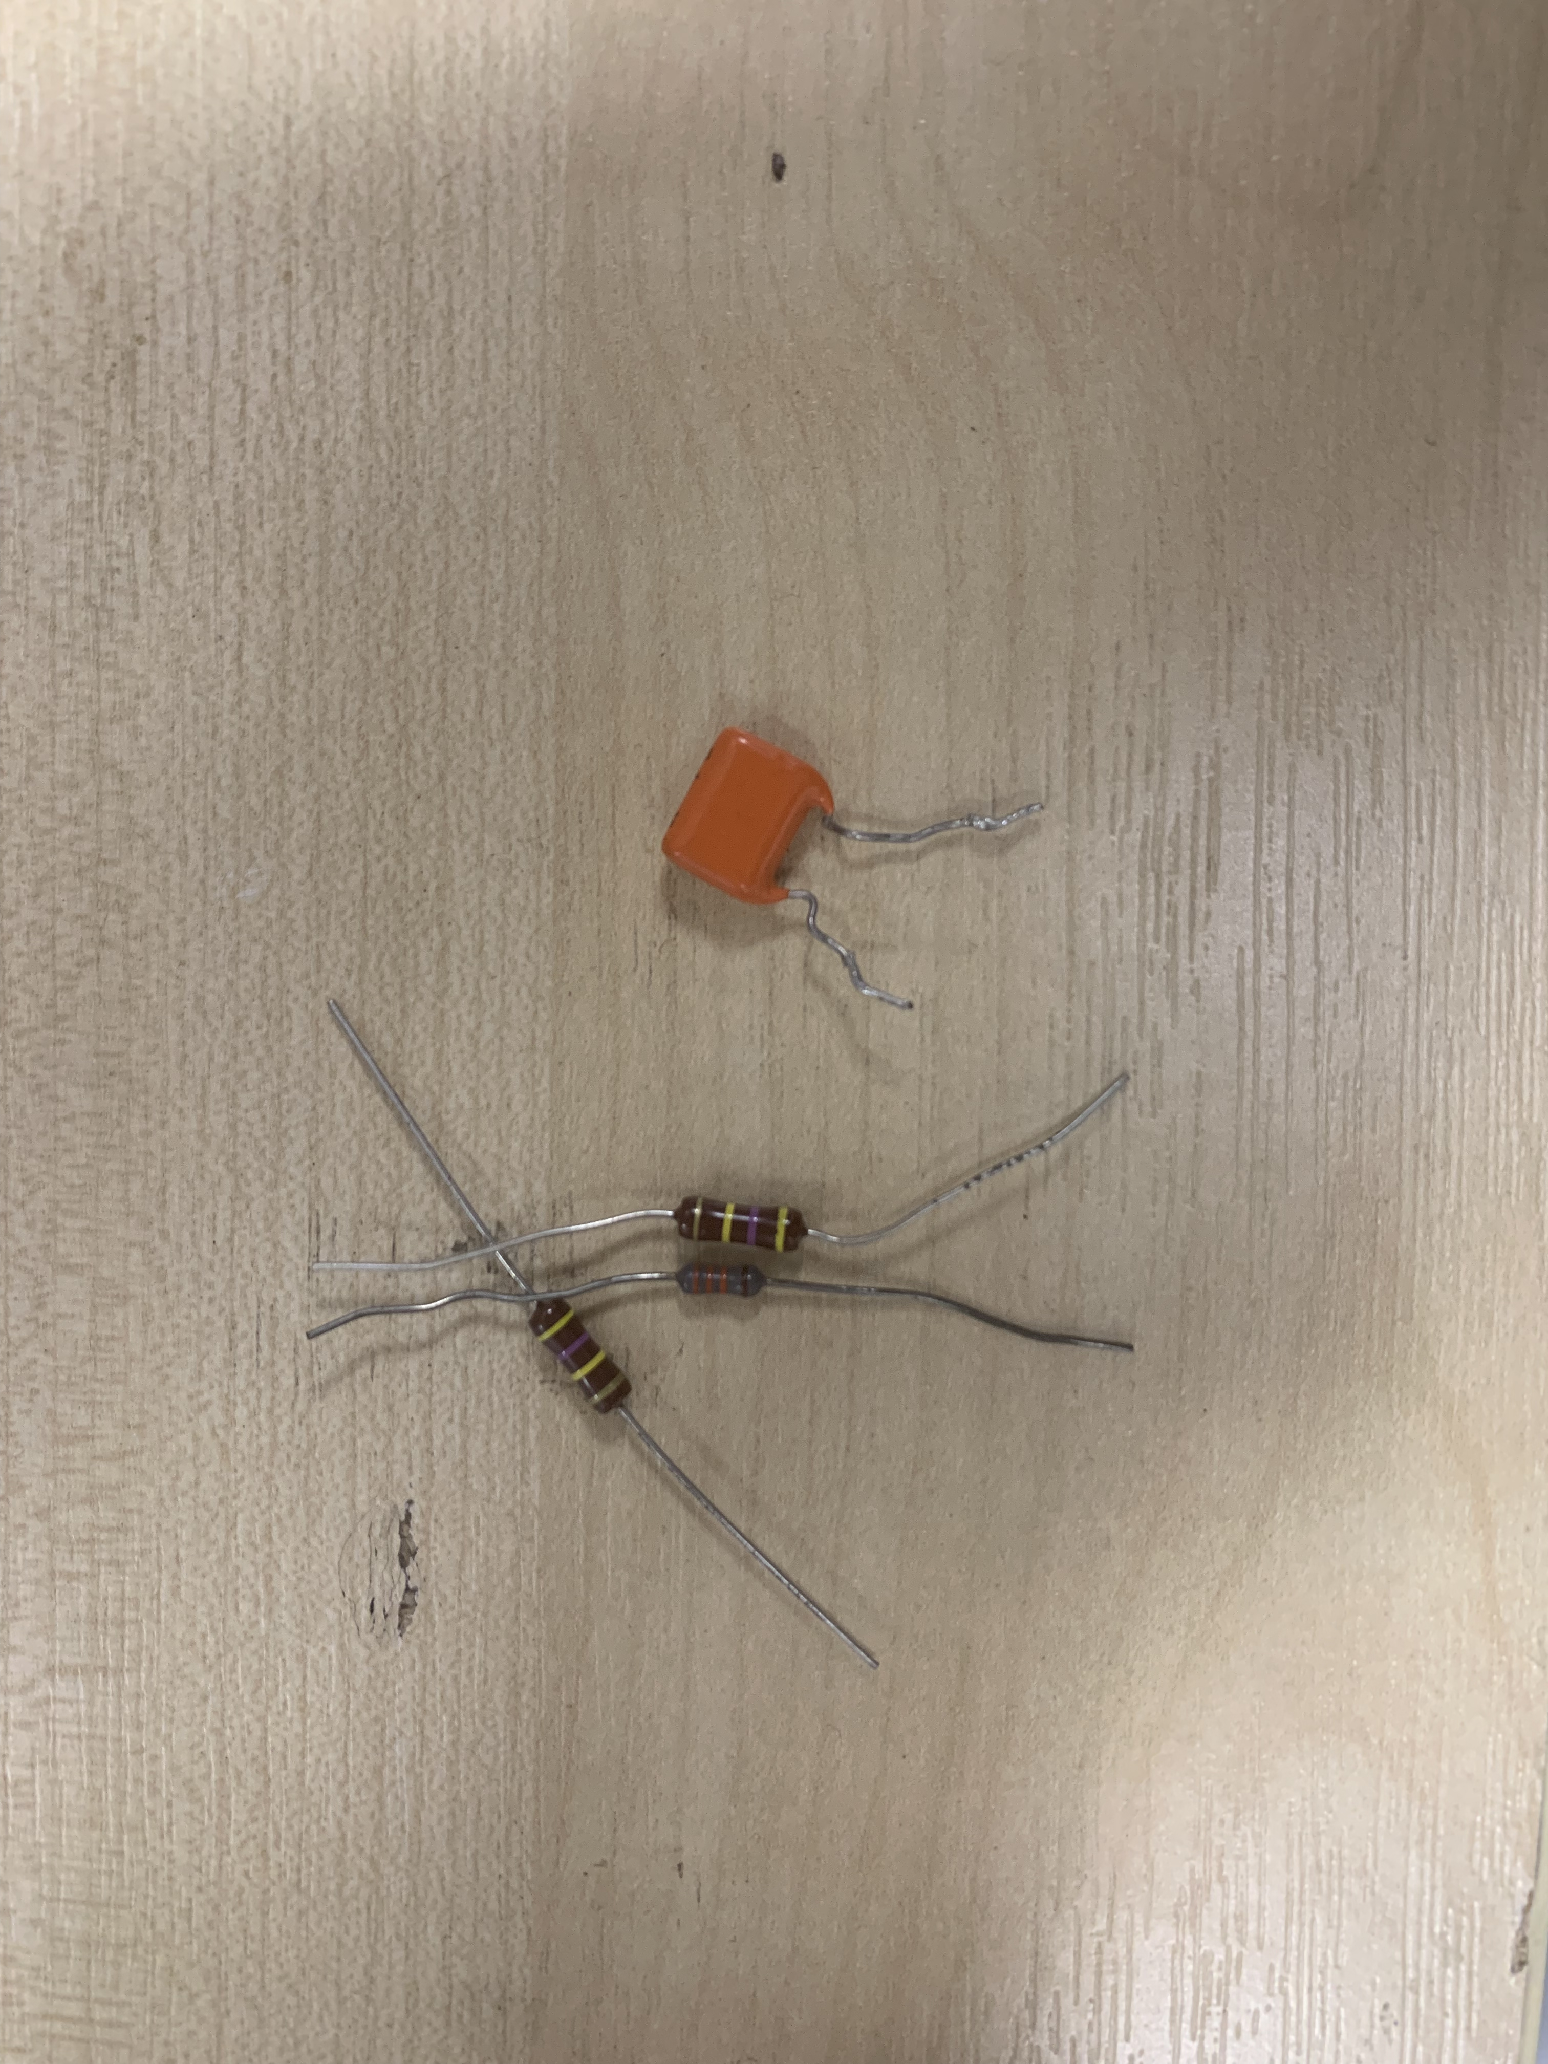
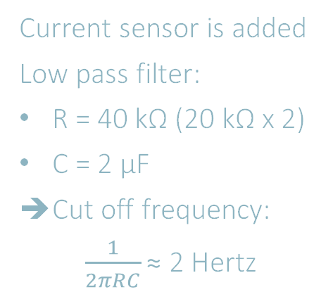
Current sensor is added
Low pass filter:
R = 40 kΩ (20 kΩ x 2)
C = 2 µF
Cut off frequency:
$\frac{1}{2πRC}\text{≈}$ 2 Hertz

Slide 5
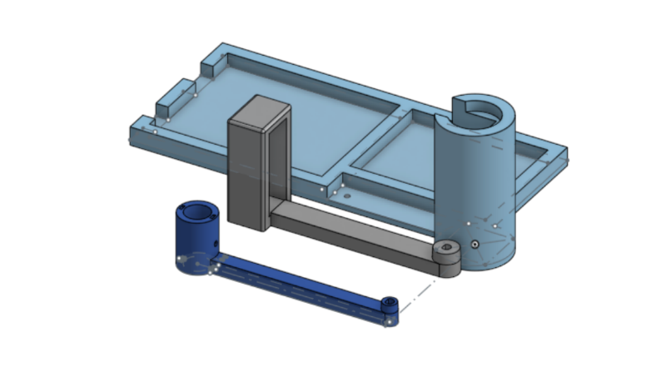
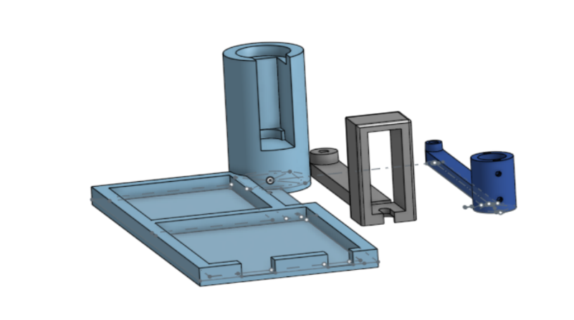
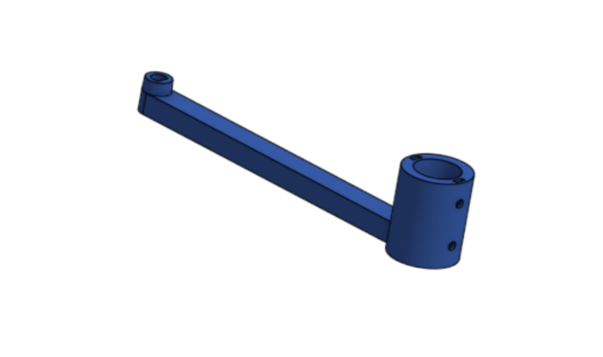
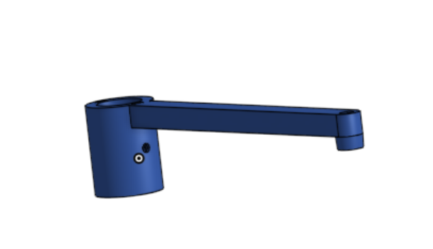
CAD/3DP

Slide 6
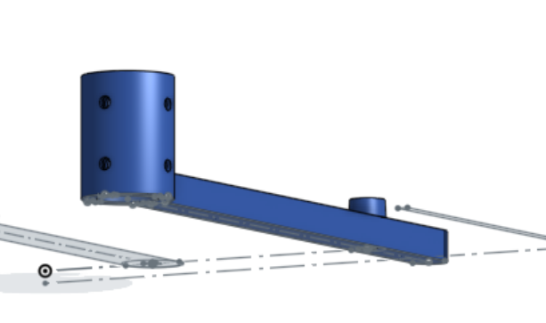
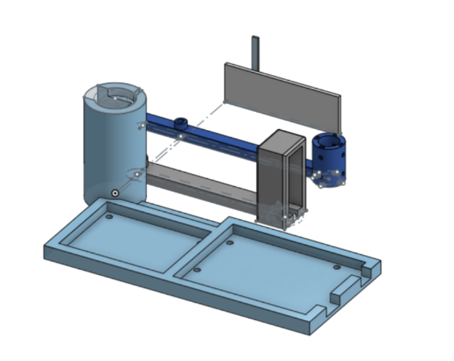
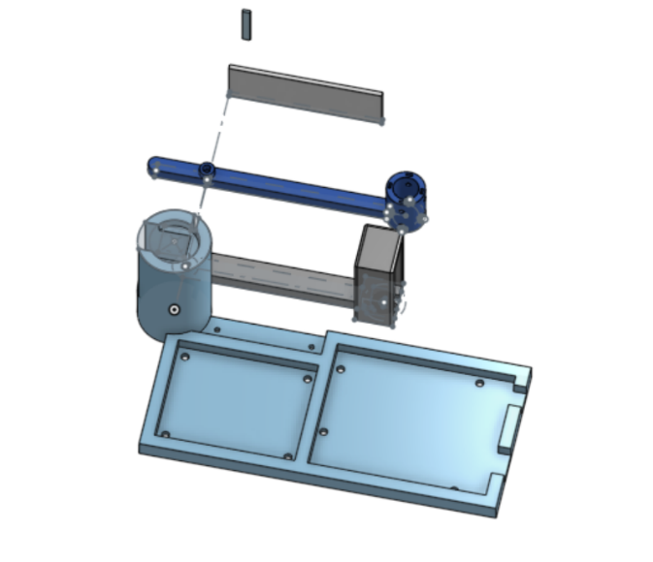
CAD/3DP

Slide 7
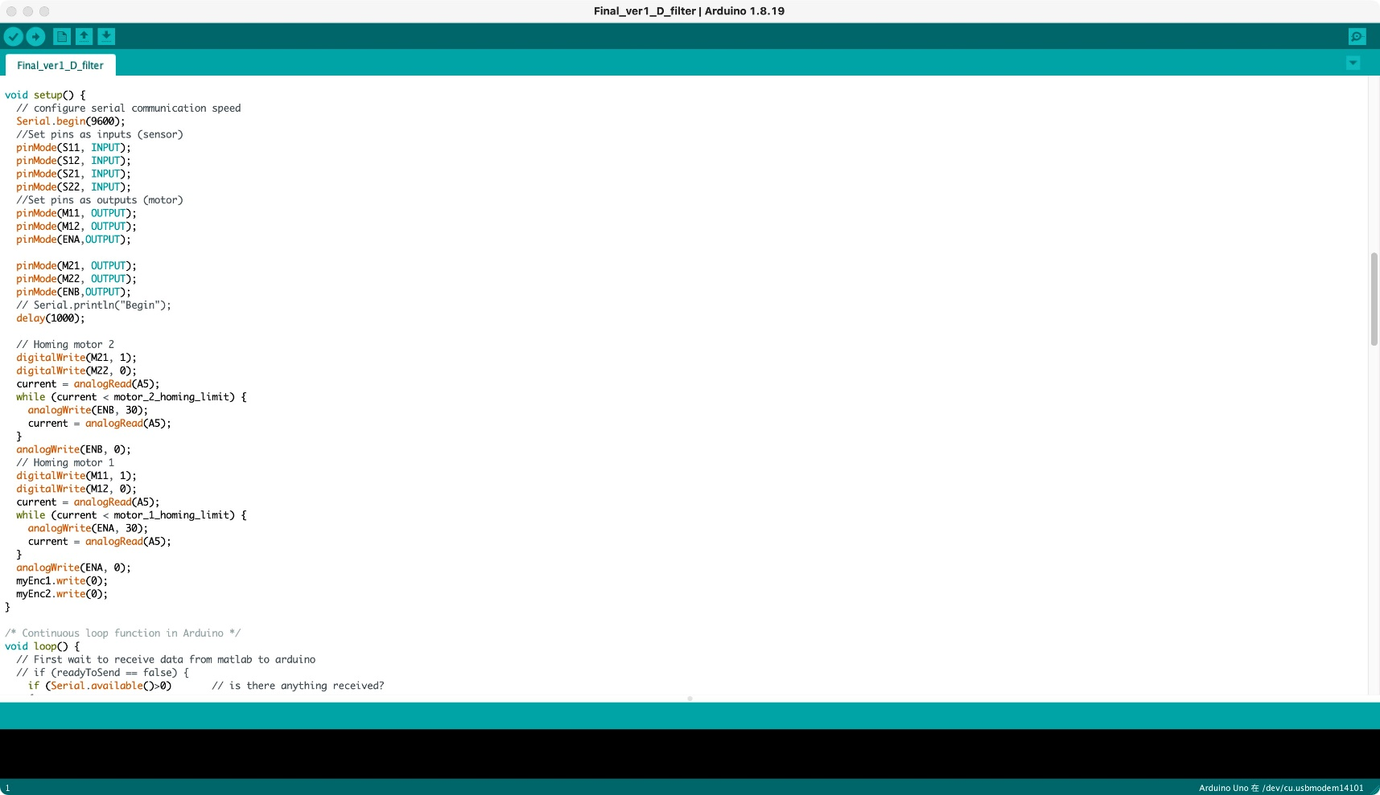
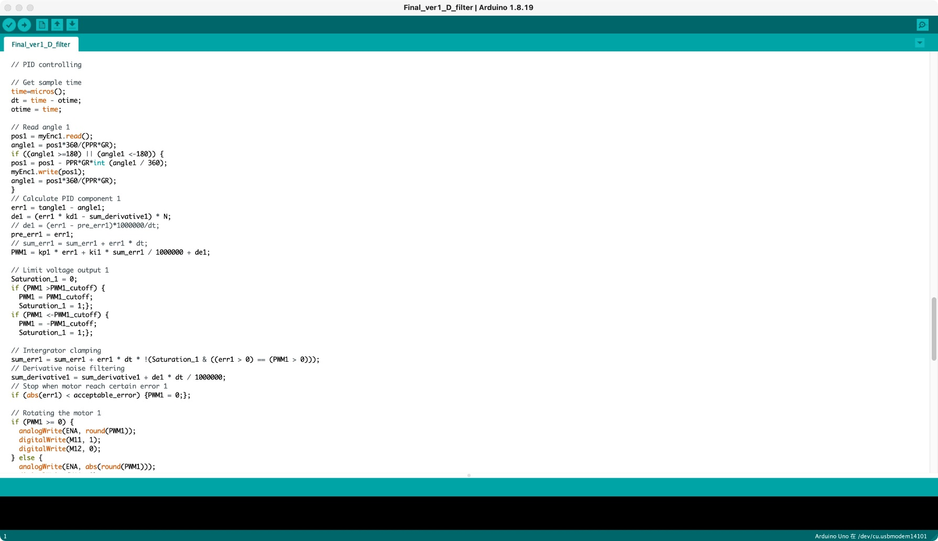
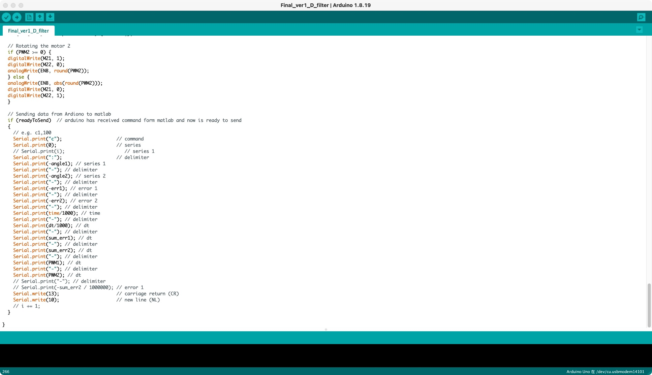
Arduino

Slide 8
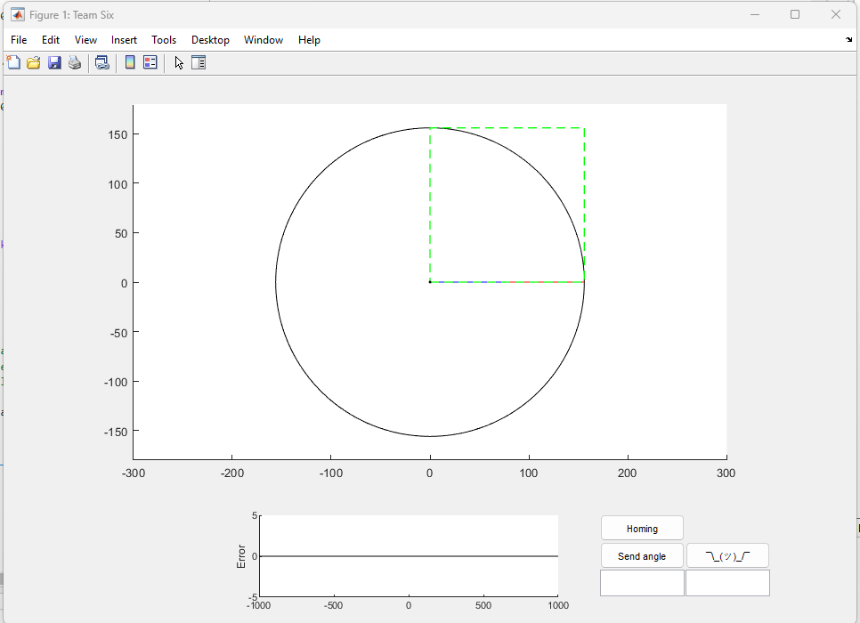
Matlab
Get current angle from Arduino -> using forward kinametics to plot
When a position is input into Matlab, inverse kinametics are called to calculate target angle to send back to arduino

Slide 9
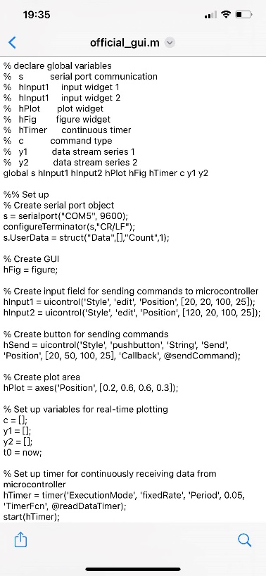
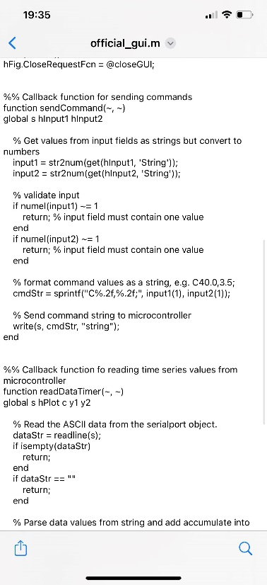
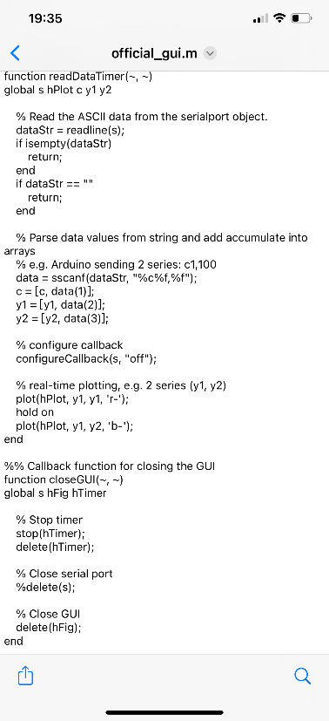
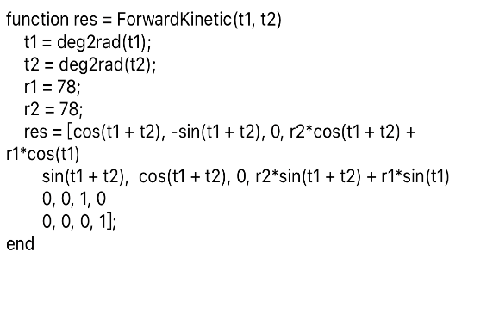
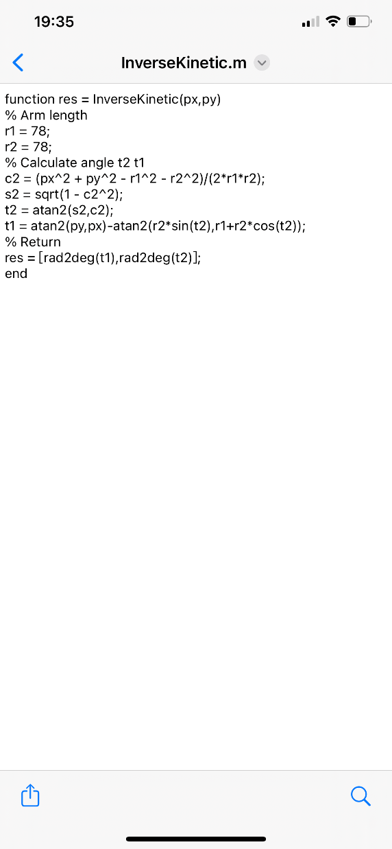
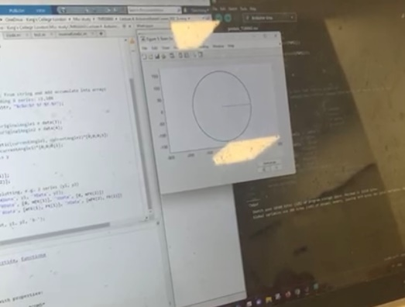
Forward/Inverse
Kinematics
FORWARD
MATLAB GUI
INVERSE

Slide 10
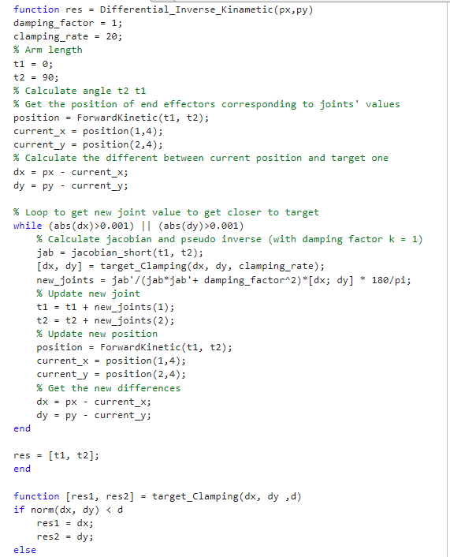
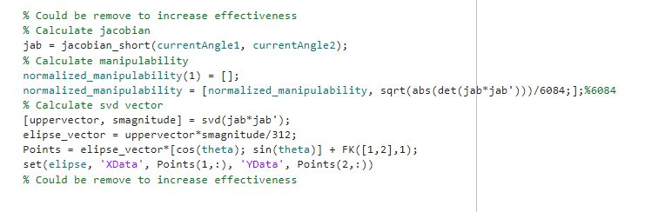
Differential inverse
Kinematics
Calculating and plotting manipulability and manipulability ellipsoid

Slide 11
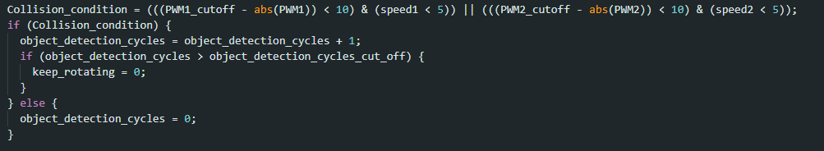
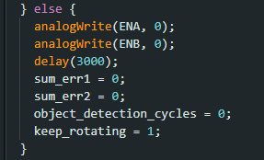
Object detection
Approach using the relation of PWM and velocity instead of current sensor

Slide 12
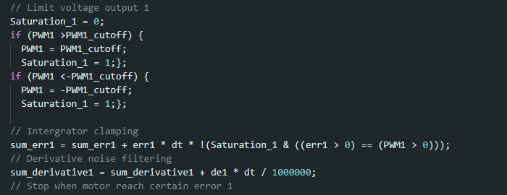
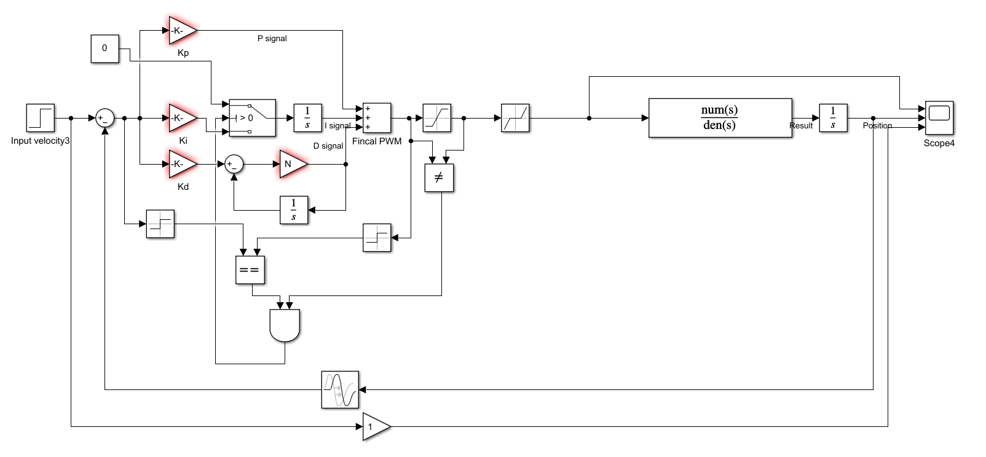
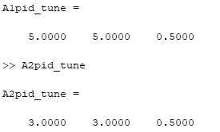
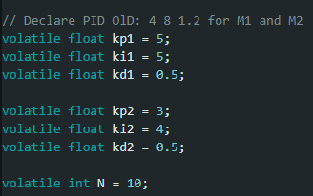
NEW PID
Integral clamping
(Main reason for improvement of control)
Derivative noise filtering
(Just do it for learning purpose)
PID tuned through simulation
Real PID after tuned in Arduino

Slide 13
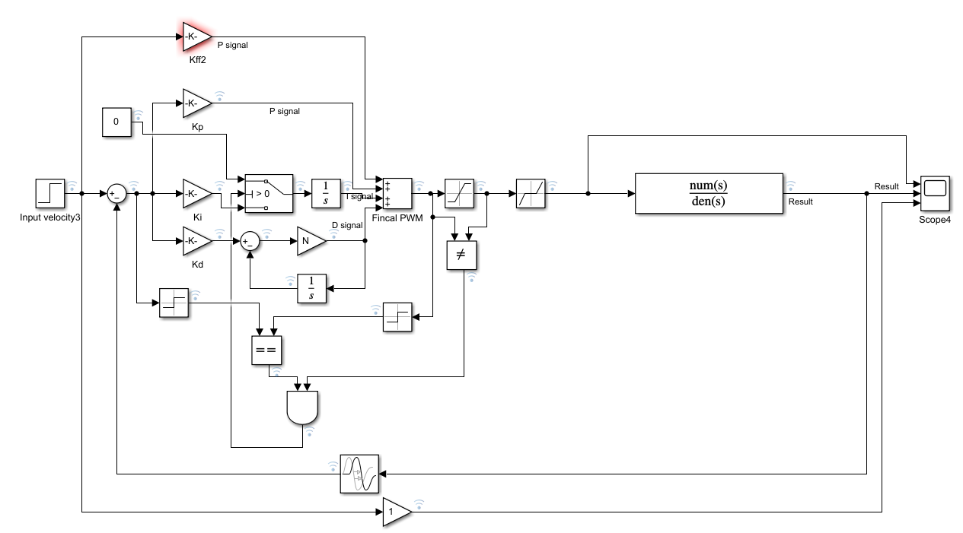
ONE FAILED APPROACH (But time consuming ☹)
Trying to move the robot through controlling speed + differential inverse kinametics
=> but all we got is BAD trajectories

Slide 14
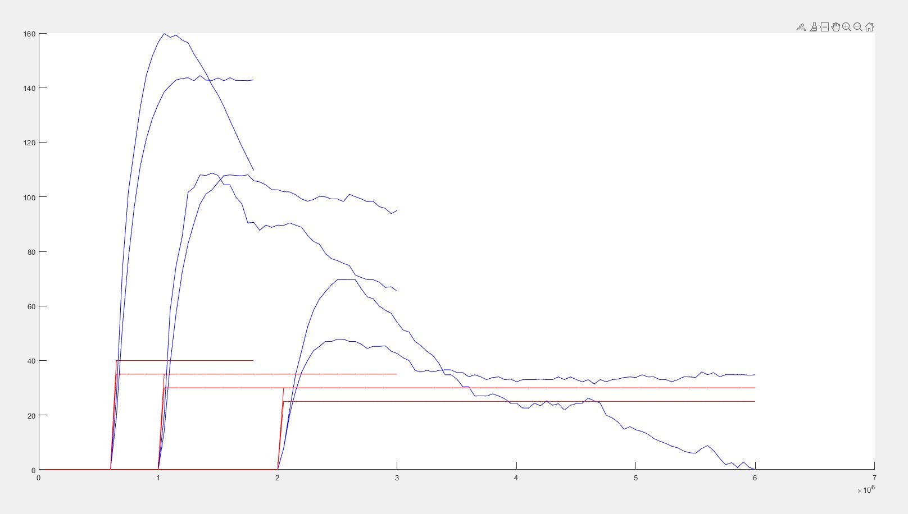
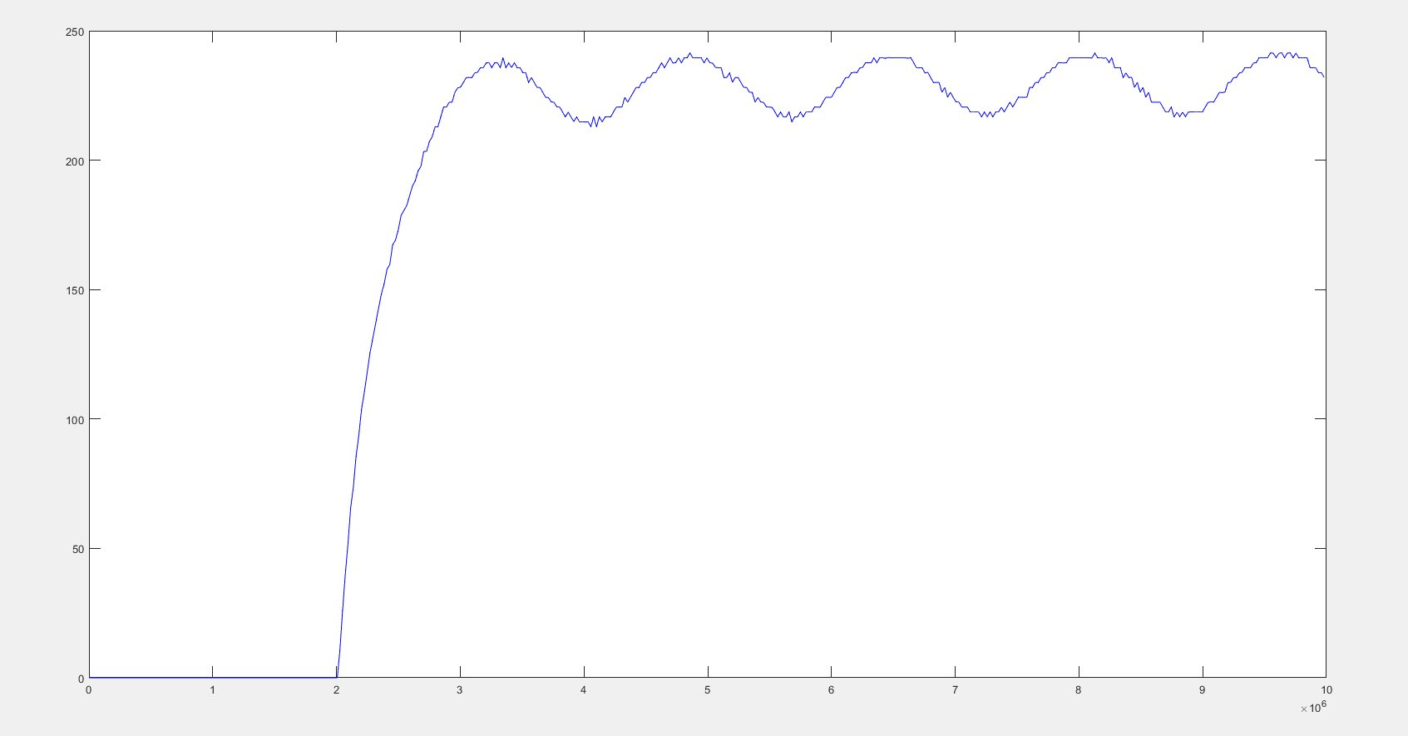
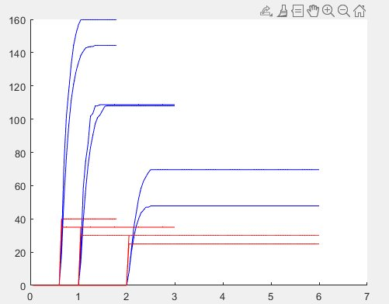
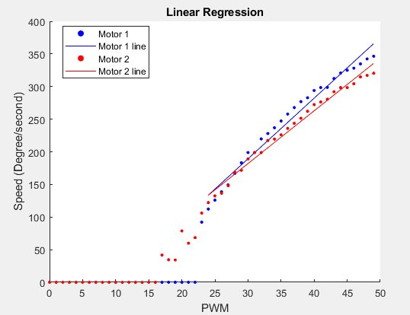
Some other figures

Slide 15
Future Plan (If we still have the future)
Different materials for the device
Control system - Wear and tear: Might try other type of control. Update control parameters automatically based on data collected
Trajectory generation + position, velocity, and acceleration control, objects avoidance, get trajectory from image/videos, …

Slide 16
PRACTICAL OPERATION

Slide 17
Thanks For Watching!

